Slide 1



Weekly Report
Speaker :Ying Jie

Slide 2

Content
1. Basic Knowledge Learnig & Works
· Survey
2. Paper Reading
· Dual-camera design for coded aperture snapshot spectral imaging
· Tesla Visual Scheme：Vision for Model 3
· A review for optical camera communication
3. Plan For Next Week
· Finish most parts for my survey
· Paper Reading & rethink for ideas

Slide 3
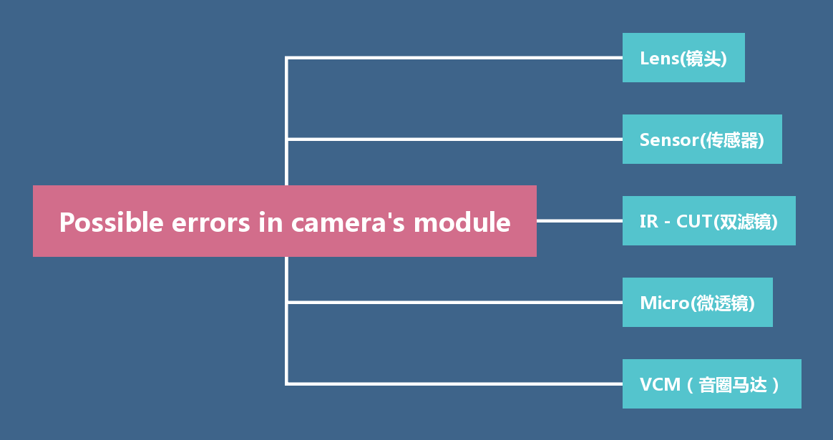

Summarize of camera’s module

Slide 4
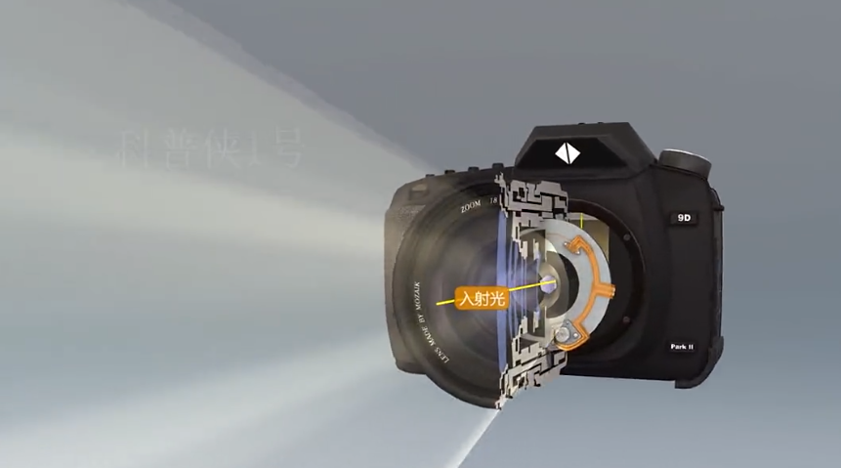
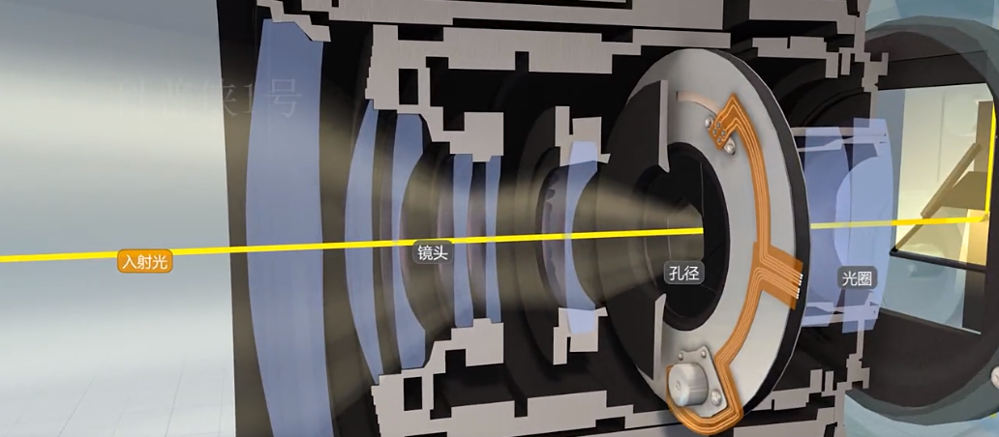
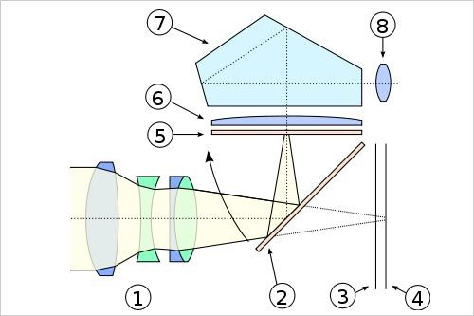
The frame of digital camera
lens & sensor

Slide 5
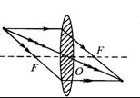
Principle of lens —— Ideal lens
Ideal optical system:
1. The ray manager parallel to the optical axis must pass through the image focus after the optical system;
2. The light manager of the object focus should be parallel to the optical axis after the optical system;
3. The direction of light at the festival point is unchanged;

Slide 6
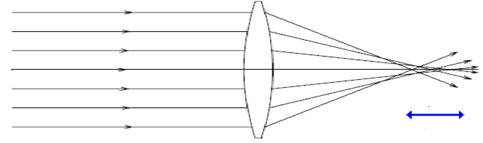
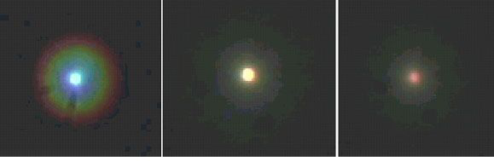
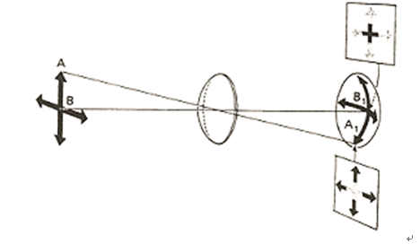
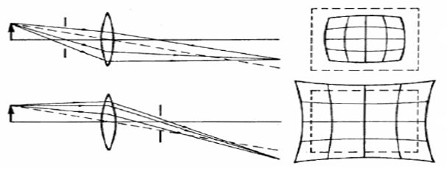
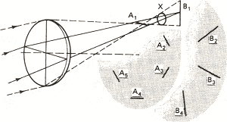
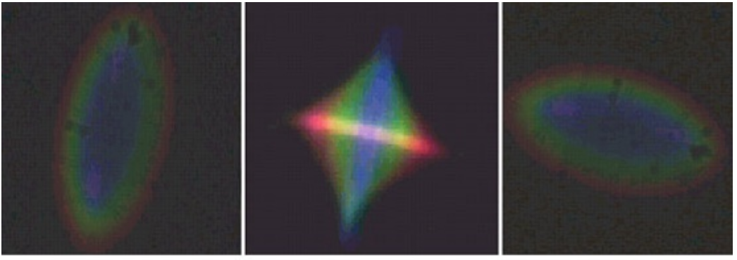
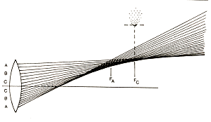
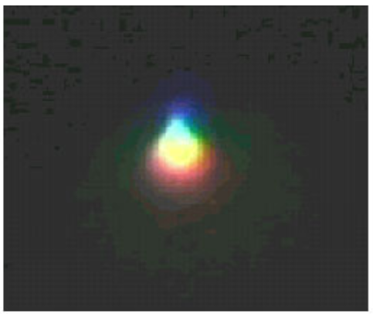
Aberration - an important cause of image distortion, blurring and color difference
Spherical aberration
Pezwar image field curvature
distortion
astigmatism
coma

Slide 7
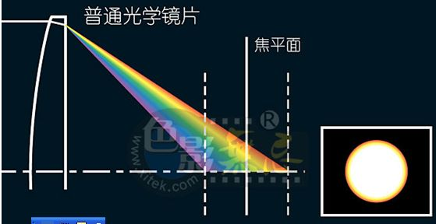
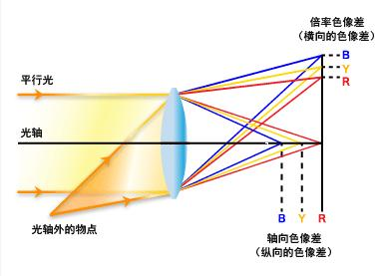
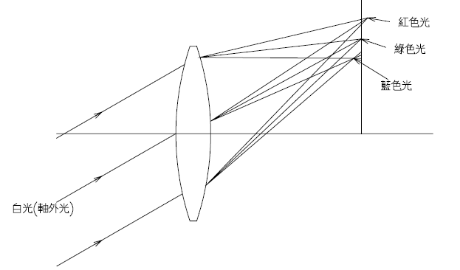
Aberration - an important cause of image distortion, blurring and color difference
Axial chromatic aberration
Chromatic difference of magnification

Slide 8
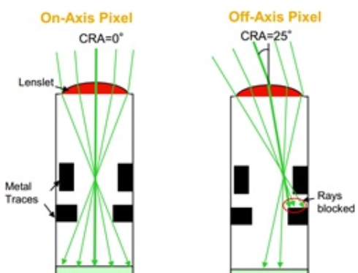
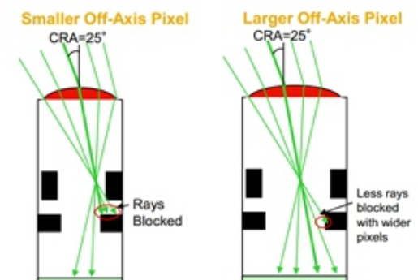
CRA (chief ray angle)
1. Wide-angle lens
2. Ultra telephoto lens
3. Zoom lens
Choose a correct CRA for sensor:

Slide 9
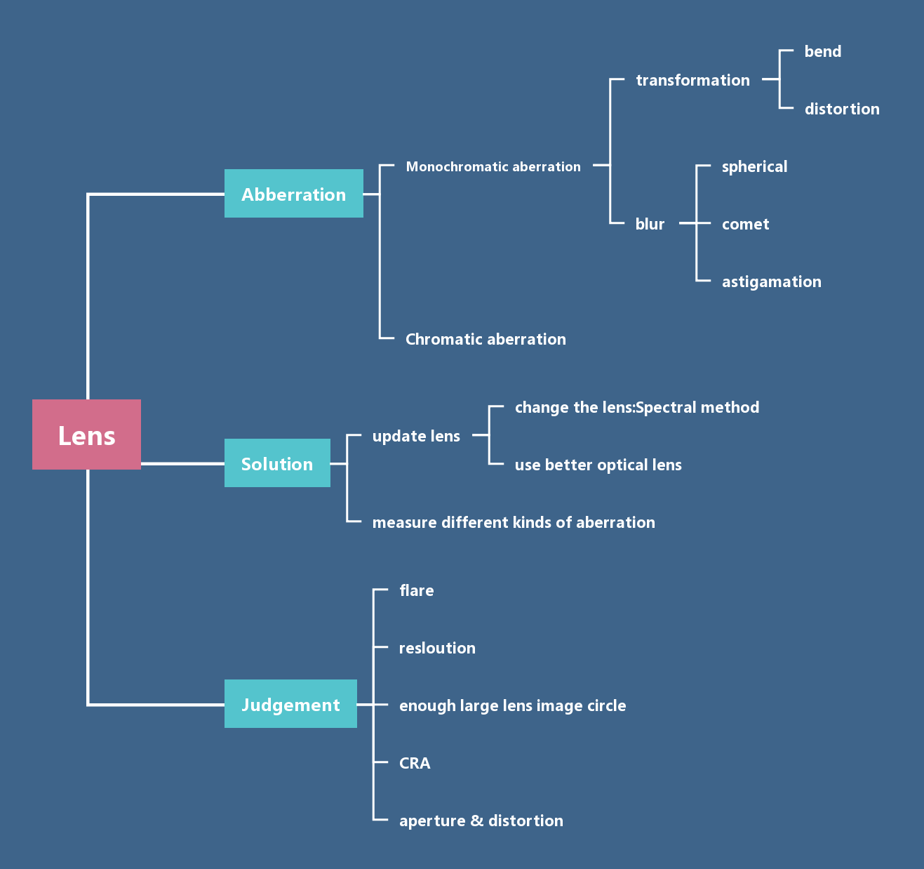
Summarize of lens

Slide 10
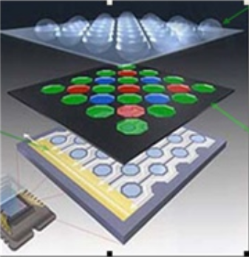
CMOS or CCD —— Choose & Improve our sensor
Micro lens
Sensor substrate
Add a layer of "glasses" in front of the sensitive layer
Photoelectric conversion, sent to the image processing unit, image restoration
Color filter
Add a layer of filter to produce a colored light source
CCD
CMOS

Slide 11
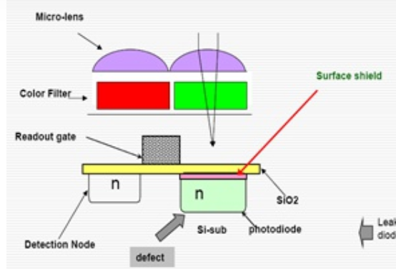
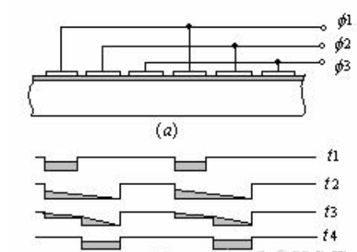
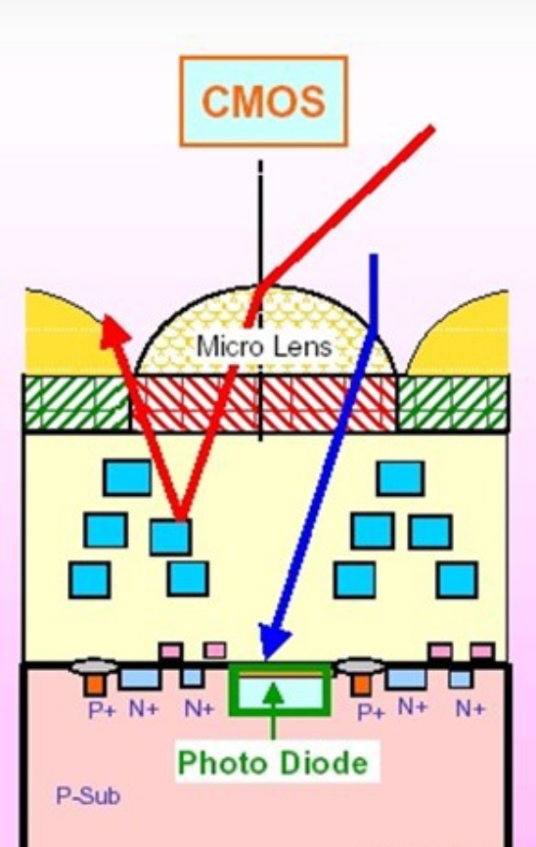
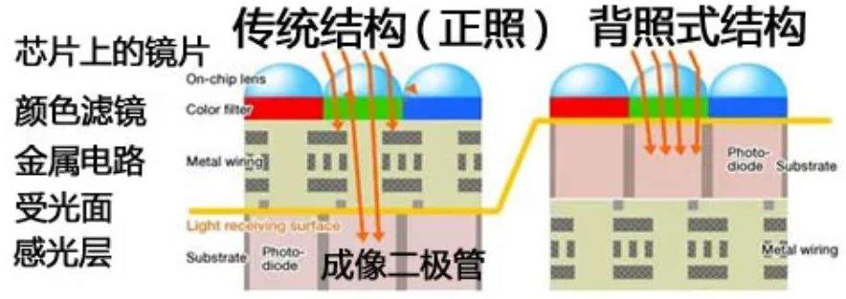
Photographic principle of CCD & CMOS

Slide 12
Some problems between CMOS
Problem:
1. Random noise
2. Fixed image noise (FPN)
Manifestation:
Transfer deterioration (low illumination black spots and colored straight lines); The photodiode sightseeing degree is not uniform (bright white spots, bright spots, black spots and bright markings).

Slide 13
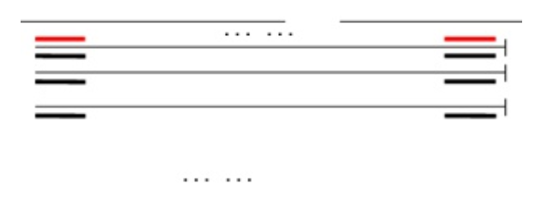
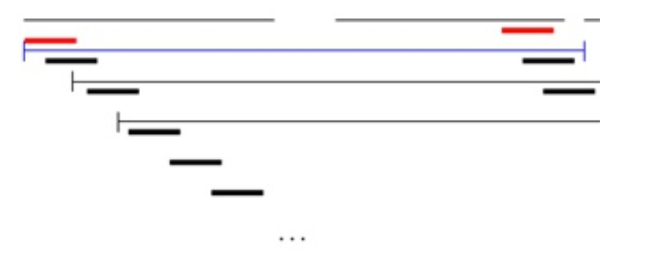
Compare between CMOS & CCD
CCD
CMOS

Slide 14
Dual-camera design for coded aperture snapshot spectral imaging
# Paper Abstract：
1. Provenance：Applied optics
2. Author：
3. Cites：117
Goals:
A novel dual-camera design is proposed to improve CASSI's performance while maintaining its snapshot advantage.
This uncoded grayscale measurement, combined with coded CASSI measurements, greatly simplifies the reconstruction problem and produces high quality 3D spectral data. Simulation and experimental results demonstrate the effectiveness of the proposed method.

Slide 15
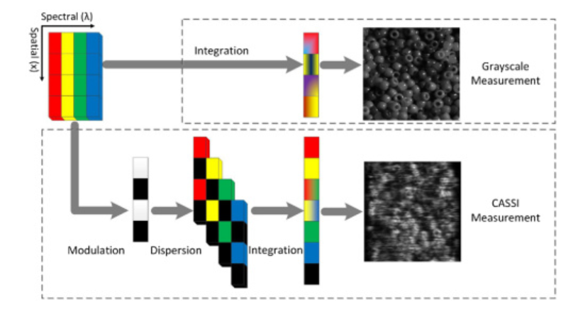
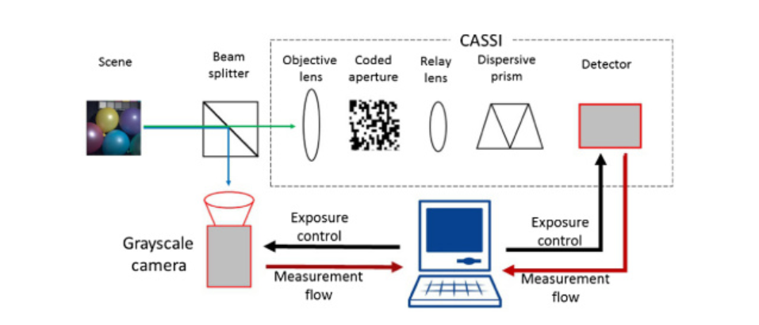
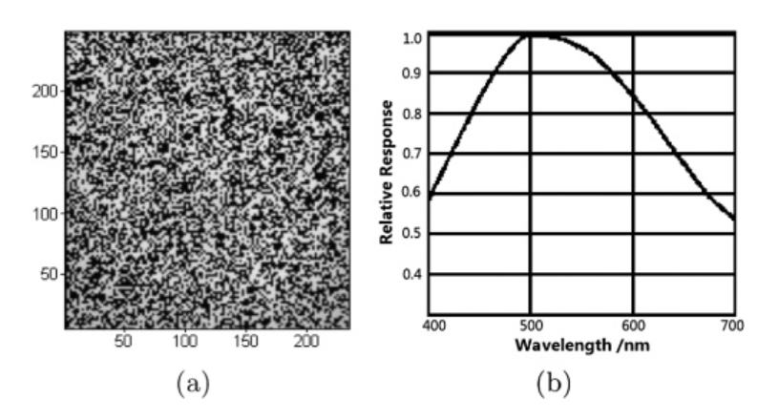
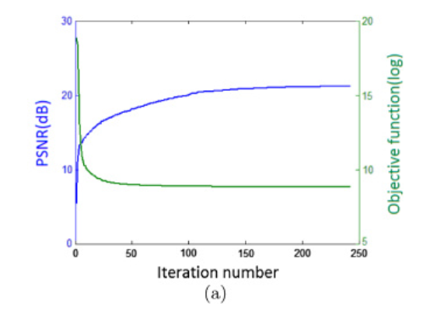
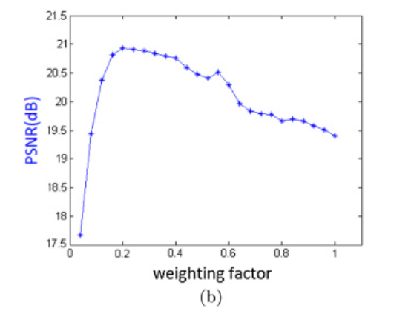
Dual-camera design for coded aperture snapshot spectral imaging

Slide 16
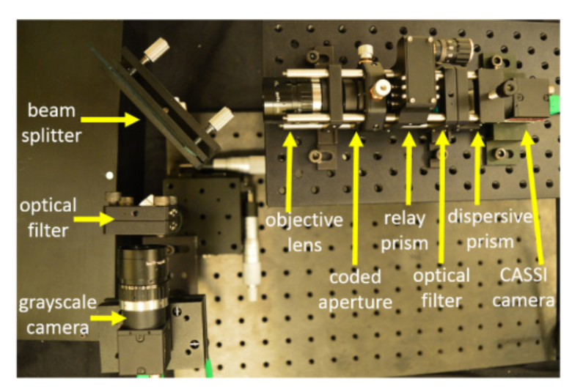
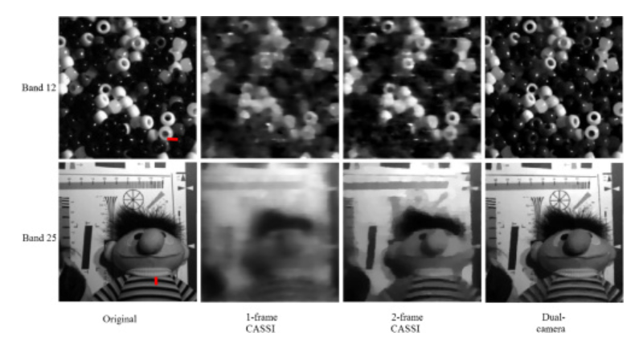
Dual-camera design for coded aperture snapshot spectral imaging

Slide 17
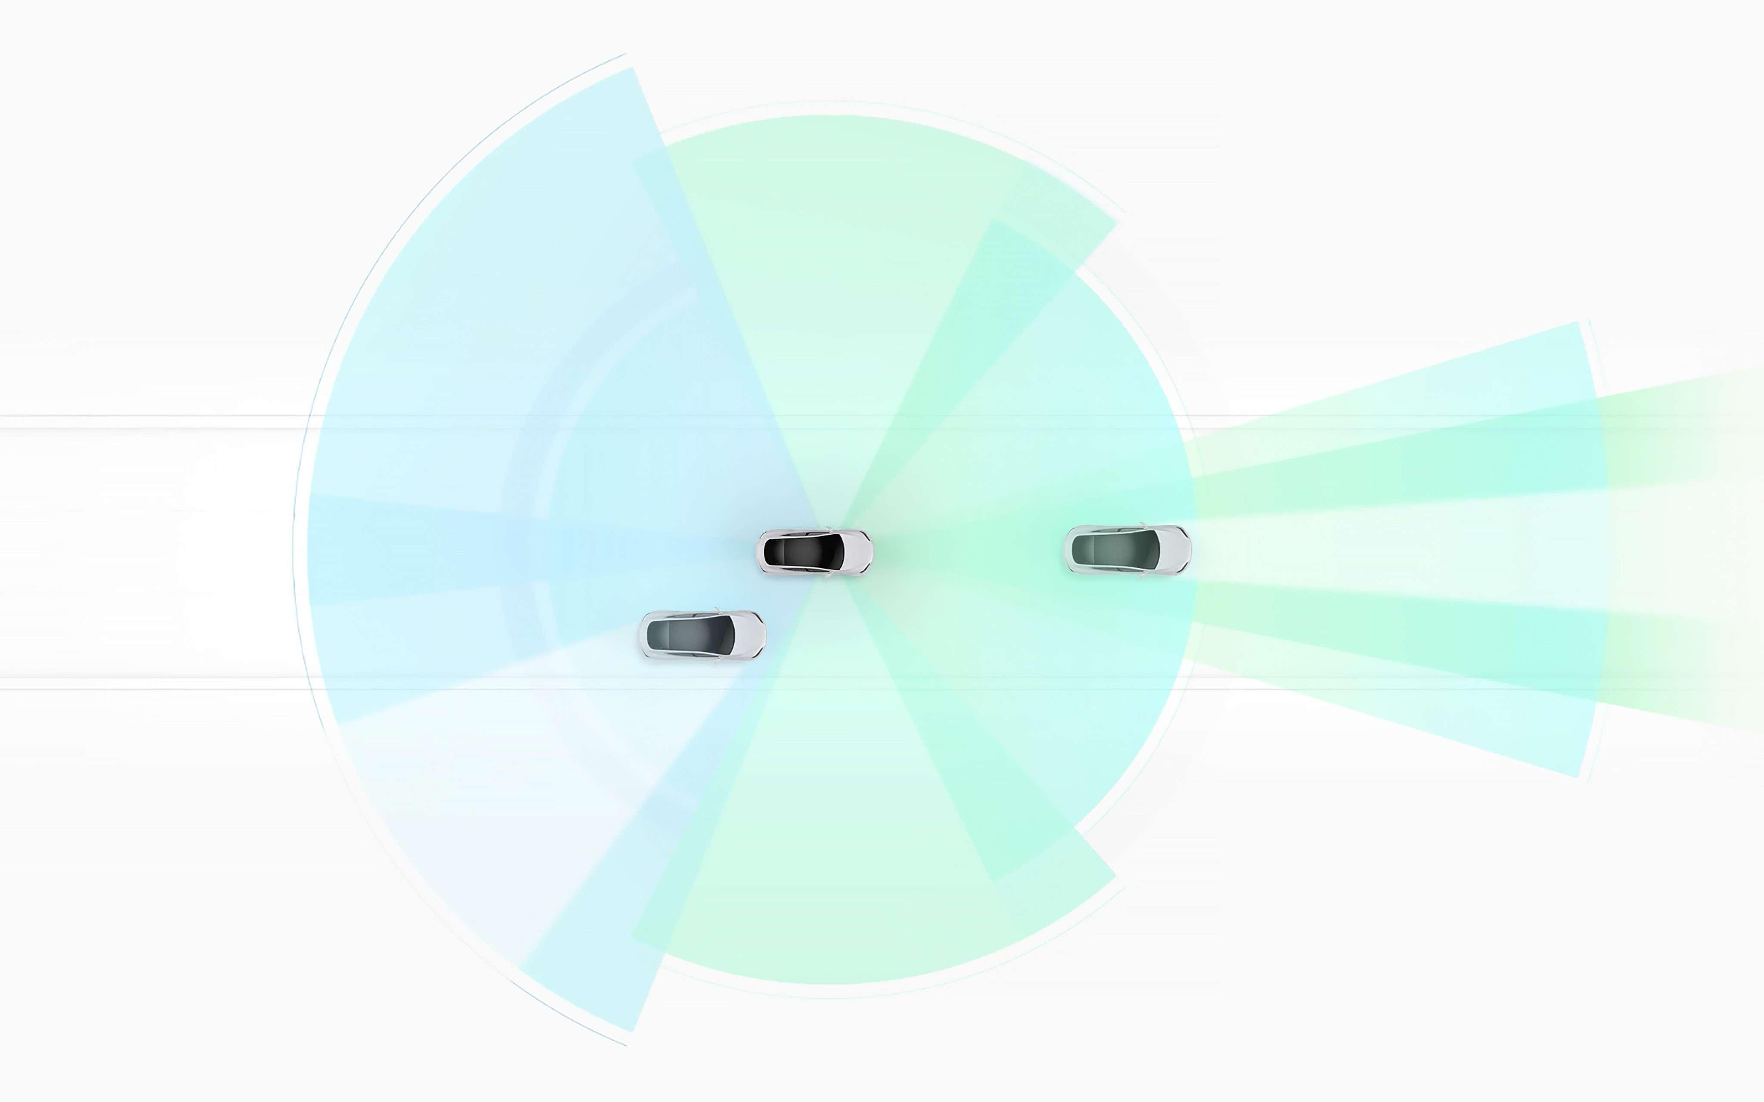
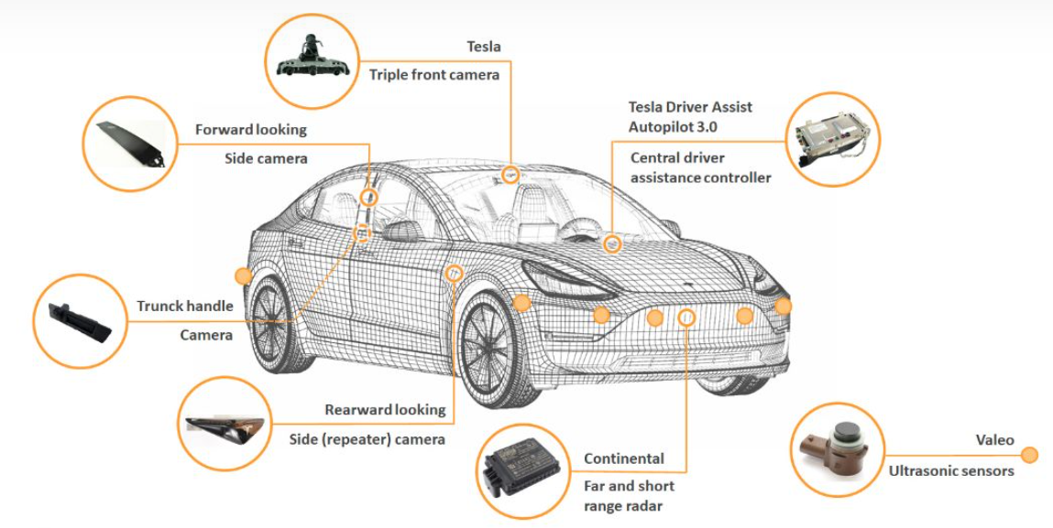
Tesla Vision —— Fusion of lidar & camera

Slide 18
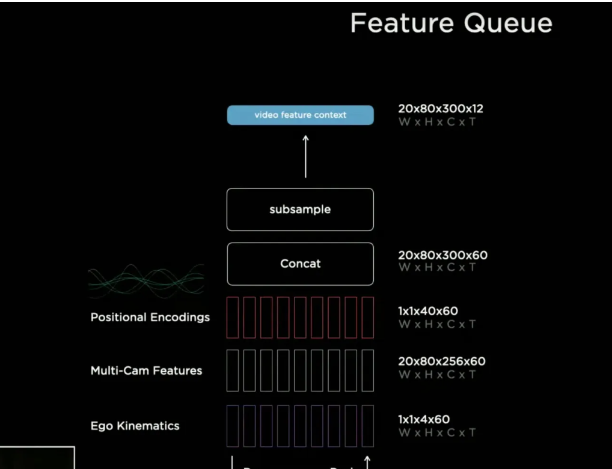
Tesla Vision —— Fusion of lidar & camera
Problem 0 - Occupancy Tracker
Tech 0 - Learning where to look.(image->BEV + multi-cam fusion)
1. Across-camera Fusion and tracker are difficult to write
2. Image space is not output space
Tech 1 - Variations in Camera Calibration(Rectify)
Problem 1 - Per-cam detection then fusion
Problem 2 - Per-cam detection then fuse

